Slide 1
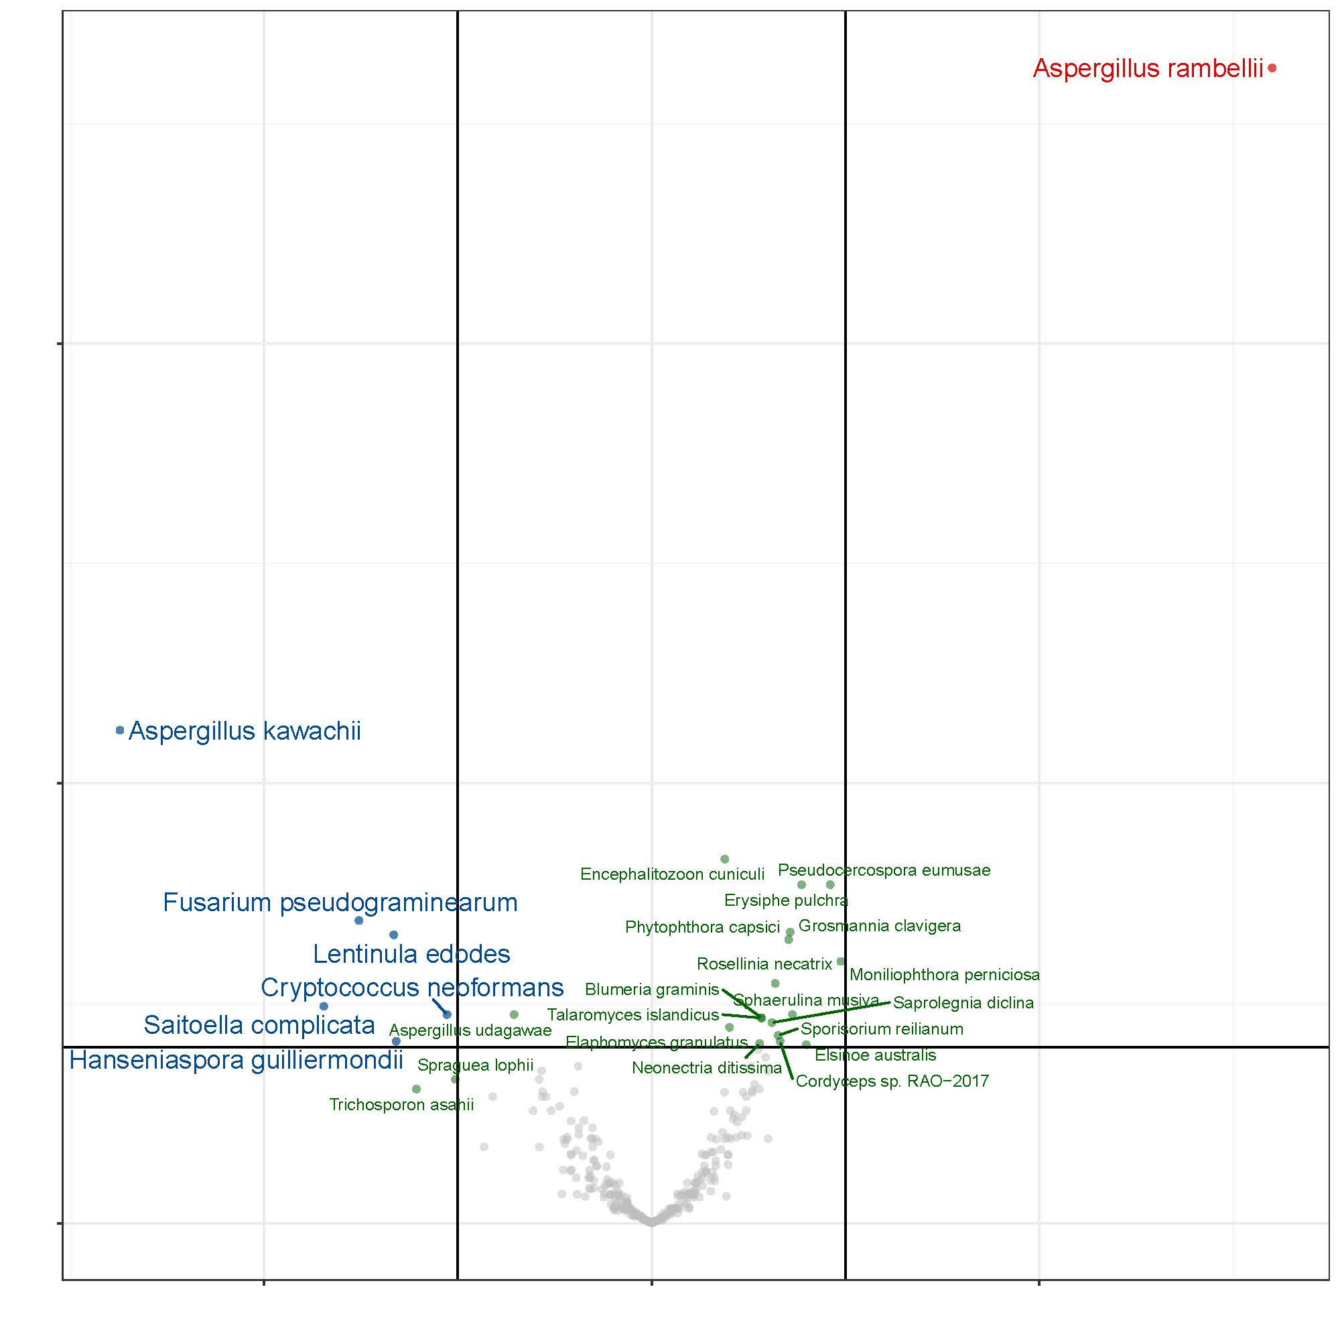
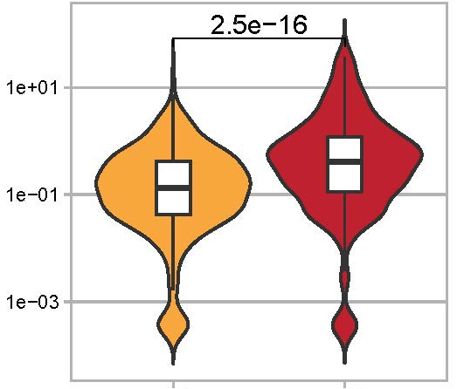
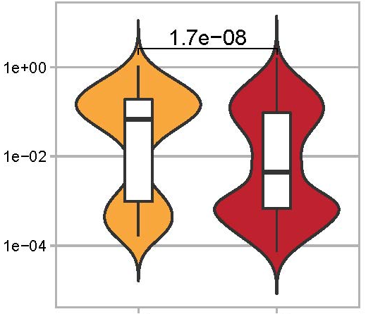
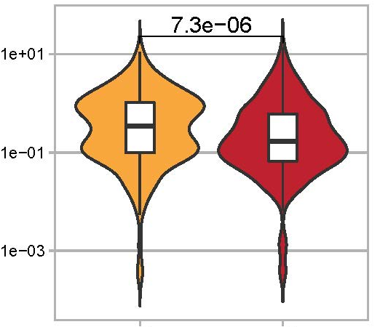
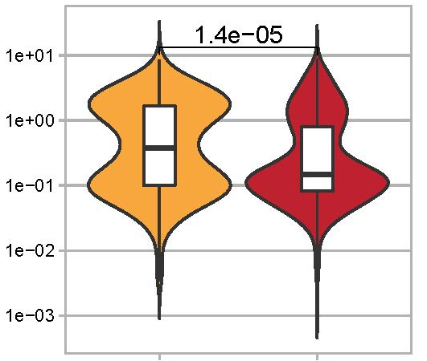
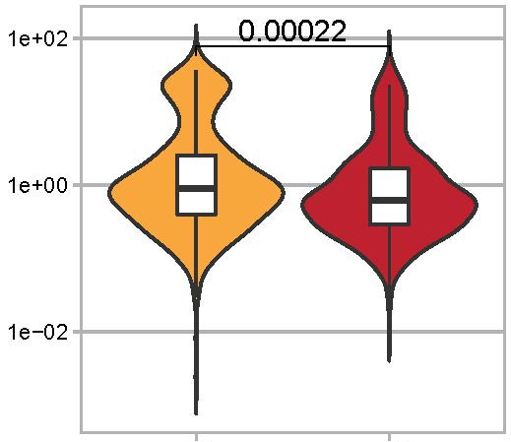
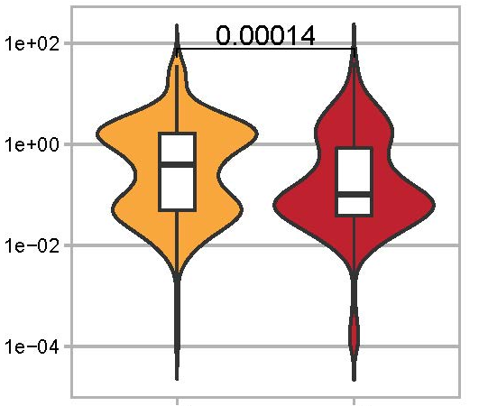
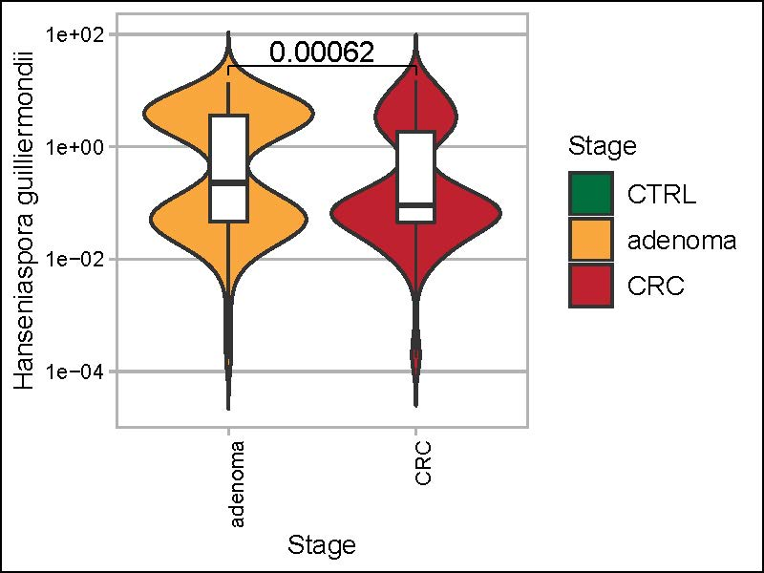
a
b
Aspergillus rambellii
Aspergillus kawachii
Fusarium pseudograminearum
Lentinula edodes
- log₁₀ FDR
10
Cryptococcus neoformans
Saitoella complicata
Hanseniaspora guilliermondii
5
-1.0
0
-0.5
0.0
0.5
1.0
log₂ FC
S figure

